Slide 1
Group meeting 26.3
Xiongxiao Wang

Slide 2
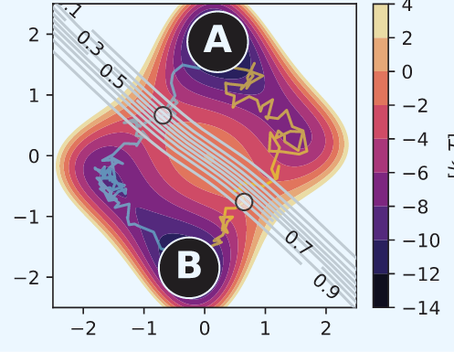
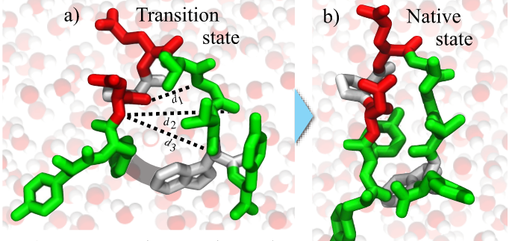
Review: TPS with AIMMD
Read papers and run code
Wolfe-Quapp
Chignolin
J. Chem. Theory Comput. 2023, 19, 9060−9076

Slide 3
The plan last week
Option 1 is a new 2D system. (e.g., the Müller-Brown potential, or the Z potential, or a 2D well with nontrivial reactive pathway).
Option 2 is to step into a new (small) MD system.

Slide 4
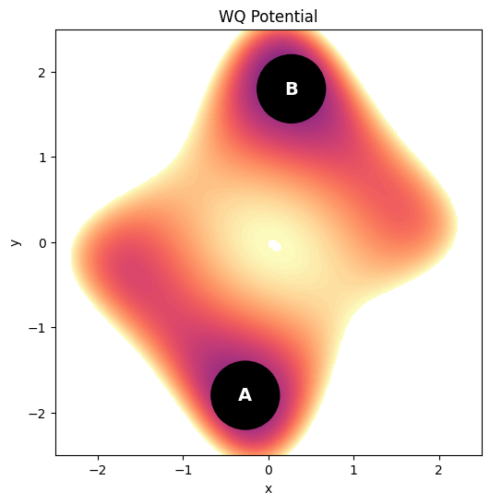
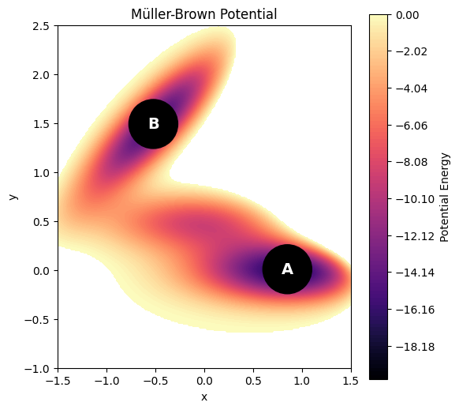
Original potential
New potential

Slide 5
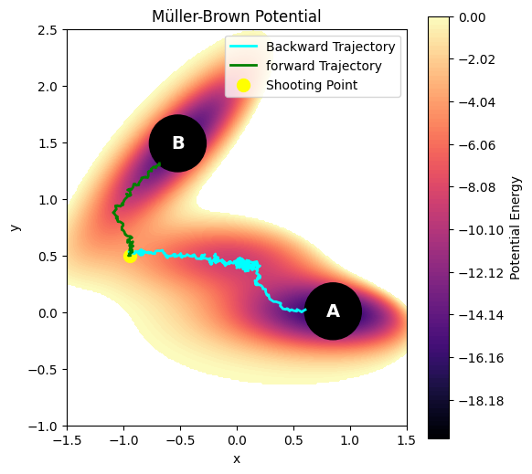
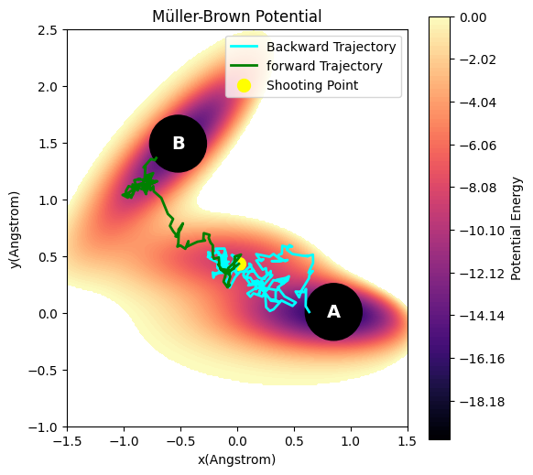
Initial trajectory
An example of transition trajectory in simulation

Slide 6
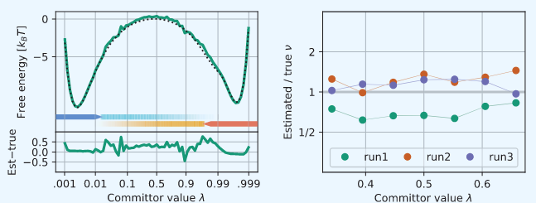
Result:
Next step: analysis
Analysis of results
Info about the path ensemble:
number of traj files: 1004
cumulative time: 120357
number of transition shots: 64
percentage of transitions: 6.4%
J. Chem. Theory Comput. 2023, 19, 9060−9076

Slide 7
Further plan
step into a new (small) MD system.

Slide 8
Group meeting 3.4
Xiongxiao Wang

Slide 9
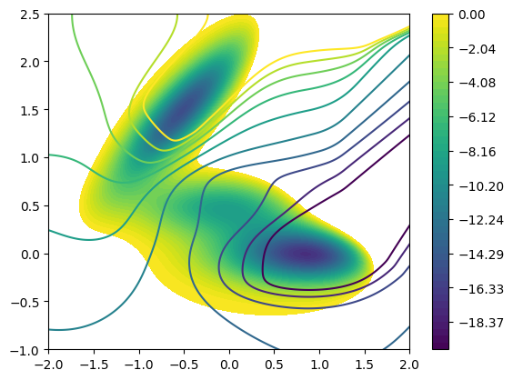
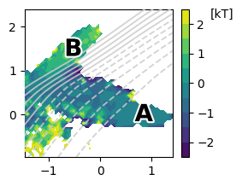
Logit committor contour plot
By equilibrium reference
By RFPS in AIMMD

Slide 10
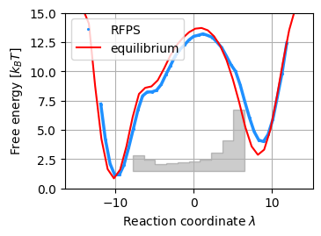

Slide 11
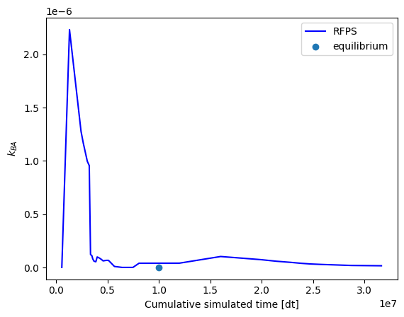
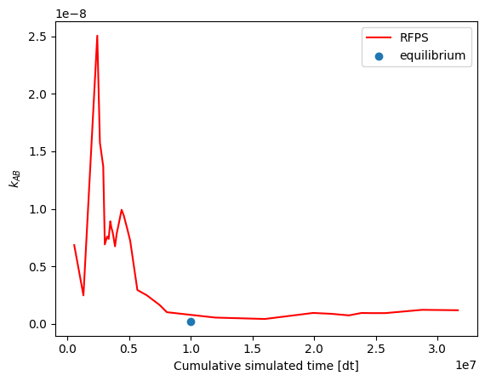
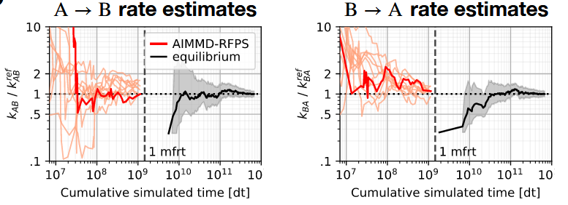
Optimal Rejection-Free Path Sampling

Slide 12
RFPS-AIMMD: Rejection-Free Path Sampling for AI for Molecular Mechanism Discovery
Xiongxiao Wang

Slide 13
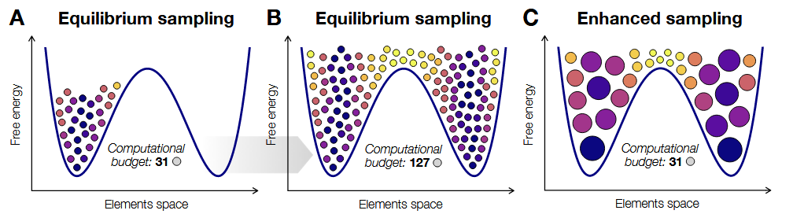
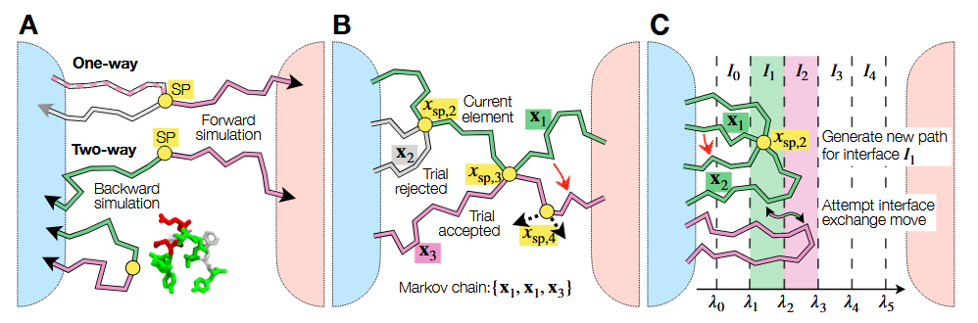
Sampling more around transition states
Introduction
A Shooting move
B Transition Path Sampling
C Transition Interface Sampling
Figures from: Lazzeri - Simulation Intelligence for Rare Events in Biomolecular Processes

Slide 14
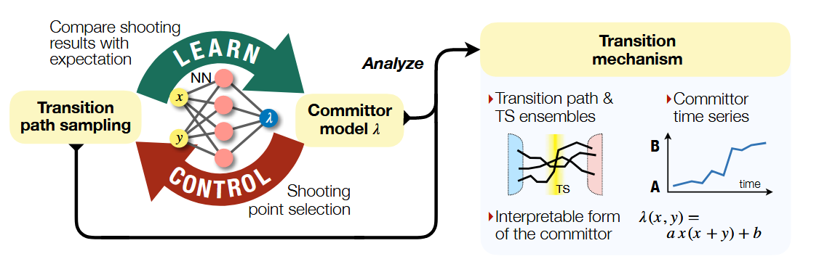
What is AIMMD?

